Slide 1
Adult Income Classification Using Machine Learning
Buhari Nasir Ahmad
Applied Programming for Data Science
Adult Census
Income Dataset
1
Notes:
Good morning.
Today I will present my Applied Programming project, which focuses on income classification using machine learning.
The goal of this project was not only to build an accurate machine learning model, but also to apply the programming concepts covered throughout the Applied Programming course. These include modular software design, object-oriented programming, data preprocessing, machine learning pipelines, exception handling, documentation, and reproducibility.
During this presentation, I will walk through the complete development process, from data loading and feature engineering to model training, evaluation, interpretability, and responsible AI considerations.

Slide 2
Income Classification Using Machine Learning
1. Project Overview
7. Feature Engineering Implementation
2. Software Architecture
8. Model Training Pipeline
3. Python Concepts Used
9. Hyperparameter Tuning
4. Data Loading & File Management
10.Model Evaluation
5. Data Cleaning Pipeline
11. Results and Reproducibility
6. Object-Oriented Programming
12. Challenges, Lessons Learned & Conclusion
2
Notes:
This presentation is organized into the following main sections.
First, I will introduce the project and the dataset.
Then I will discuss the software architecture and the Python programming concepts used throughout the implementation.
Next, I will explain the data preprocessing and feature engineering process.
After that, I will present the machine learning pipeline, model training, and hyperparameter tuning.
Finally, I will discuss the results, reproducibility aspects, challenges encountered during development, lessons learned, and the overall conclusions of the project.

Slide 3
1. Project Overview
3
Notes:
I will begin with an overview of the project and the dataset that was used for the classification task.

Slide 4
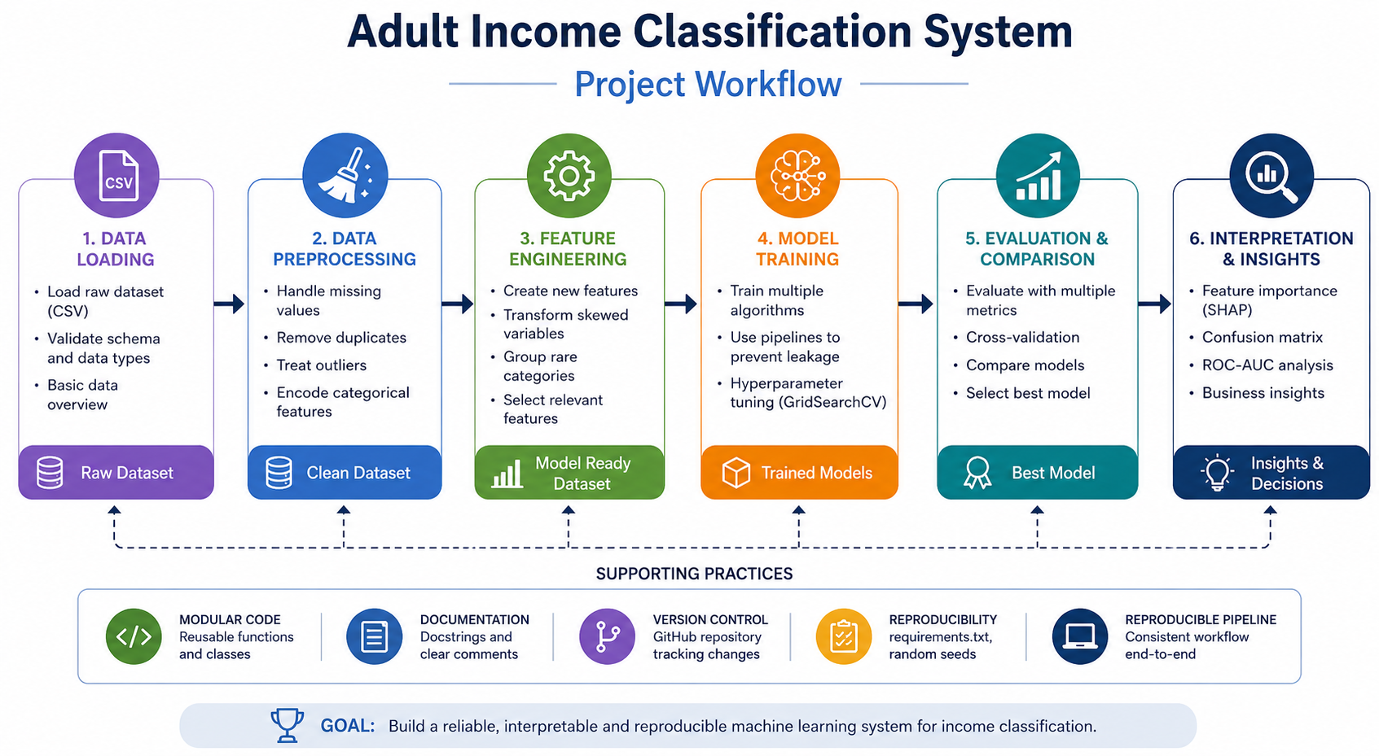
Applied Programming for Data Science
Project Overview
Adult Income Classification
Problem Statement
This is a binary classification problem. The objective is to predict whether a person's income exceeds $50,000 per year using demographic and socioeconomic information?
Predict income category (>50K or ≤50K)
Built entirely in Python
End-to-end data science pipeline
Reproducible and modular implementation
4
Notes:
This project focuses on the Adult Income Classification problem. The objective is to predict whether a person earns more than fifty thousand dollars per year based on demographic and socioeconomic information such as age, education, occupation, work class, and working hours.
From a machine learning perspective, this is a binary classification problem. However, for this course, my focus was not only on predictive performance but also on building a complete Python application following software engineering principles.
The project was implemented entirely in Python and includes data loading, preprocessing, feature engineering, model training, evaluation, interpretability analysis, and fairness assessment. Throughout the presentation I will focus on how these components were implemented using clean, modular, and reusable code.

Slide 5
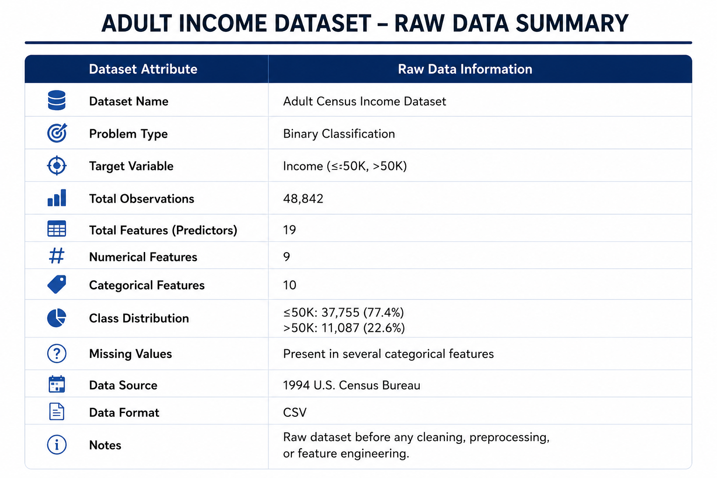
Applied Programming for Data Science
Dataset Overview
Adult Census Income Dataset
Features include:
Age
Education
Occupation
Marital Status
Workclass
Hours per Week
Capital Gain
Capital Loss
Dataset Summary
Number of observations : 48,790
Number of features: : 19
Numerical features: 9
Categorical features: 10
5
Notes:
The dataset used in this project is the Adult Census Income Dataset. It contains demographic and socioeconomic information collected from the U.S. Census database.
The dataset contains approximately forty-nine thousand observations and nineteen features, including both numerical and categorical variables. Examples include age, education, occupation, marital status, capital gain, capital loss, and hours worked per week.
Before building any machine learning models, it was important to understand the structure of the dataset and identify potential data quality issues that would need to be addressed during preprocessing.

Slide 6
2. Software Architecture
6
Notes:
After introducing the project and the dataset, the next step was designing the software architecture.

Slide 7
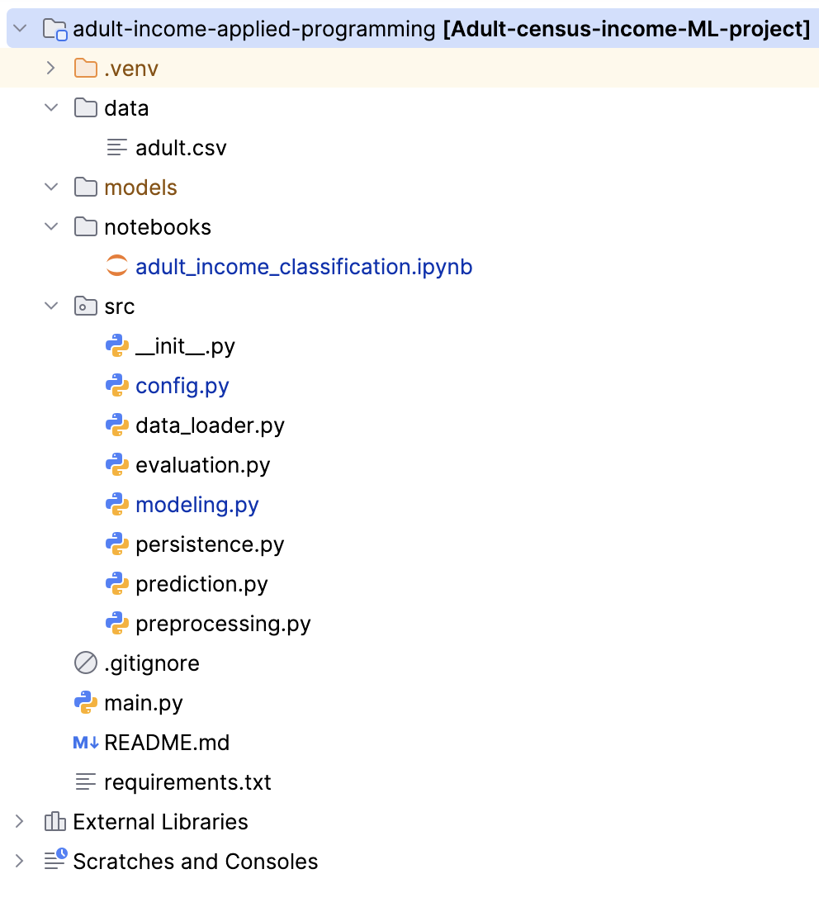
Applied Programming for Data Science
Software Architecture
Modular project structure
Separation of responsibilities
Reusable components
Easy maintenance and extension
7
Notes:
One of the main objectives of this project was to create a maintainable and reusable software structure. Instead of implementing everything inside a single notebook, I organized the project into separate modules, each with a specific responsibility.
For example, data loading, preprocessing, modelling, evaluation, and prediction logic were separated into different files. This follows the principle of separation of concerns and makes the project easier to maintain, debug, and extend.
If a new model or preprocessing step needs to be added in the future, it can be implemented without affecting the rest of the system.

Slide 8
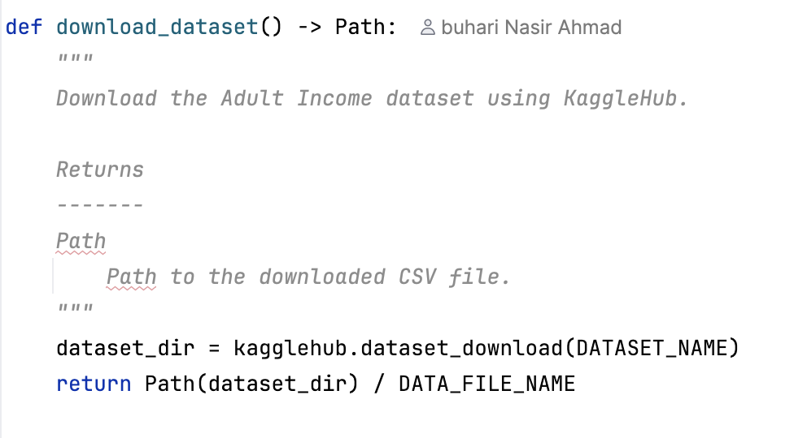
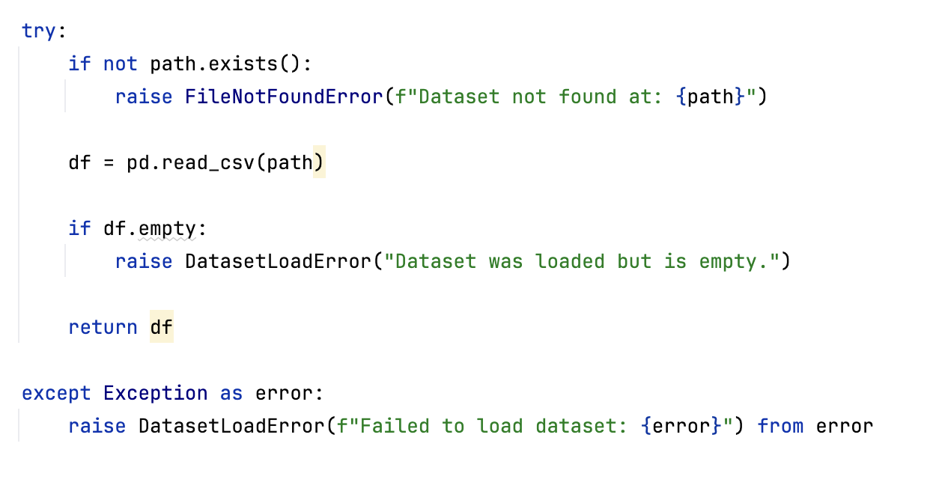
Applied Programming for Data Science
Python Programming Concepts Used
Functions
Type hints
Dataclasses
Docstrings
Pipelines
Exception handling
8
Notes:
The Applied Programming course focused heavily on writing clean and maintainable Python code. Several concepts covered during the semester were applied throughout this project, including:
Functions
type hints
dataclasses
documentation
pipelines
and exception handling.
In the next few slides, I will explain how each of these concepts contributed to the overall implementation.

Slide 9
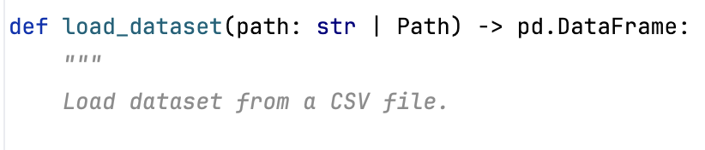
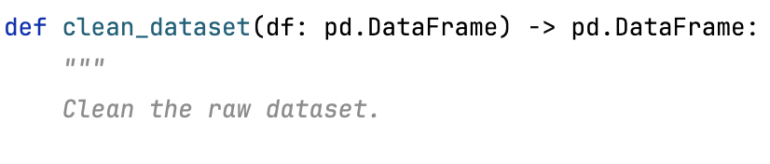
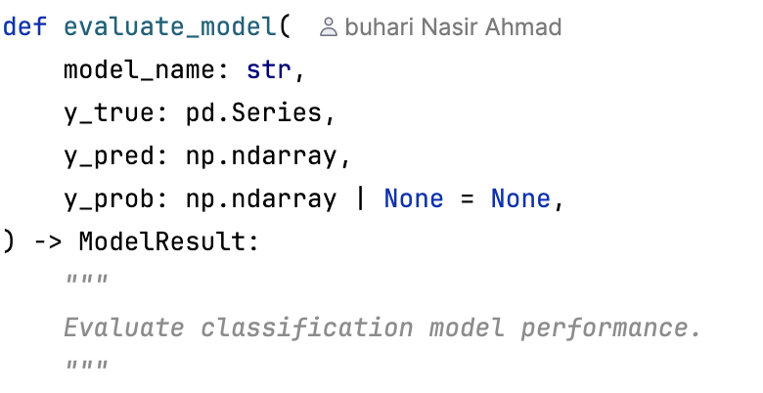
Applied Programming for Data Science
Python Programming Concepts Used
Functions & Modular Design
Reusable functions
Separation of concerns
Improved maintainability
Reduced code duplication
Key Functions
load_dataset()
clean_dataset()
engineer_features()
evaluate_model()
compare_models()
9
Notes:
Functions were used extensively throughout the project to improve modularity and reduce code duplication. Examples include loading the dataset, cleaning the data, engineering features, training models, and evaluating performance.
Each function was designed to perform a single task, which improves readability and maintainability. This approach also makes testing easier because each function can be verified independently.
By organizing logic into reusable functions, the project follows the DRY principle(Don’t Repeat Yourself), meaning we avoid repeating the same code multiple times.

Slide 10
Applied Programming for Data Science
Python Programming Concepts Used
Type Hints
Improved code readability
Better IDE support
Easier debugging
Self-documenting code
10
Notes:
Type hints were added to functions throughout the project.
They describe the expected input and output types for each function.
Although Python is dynamically typed, type annotations improve code readability and make development easier because IDEs such as PyCharm can provide better autocompletion and error detection.
Type hints also serve as a form of documentation because other developers can quickly understand how a function should be used.

Slide 11
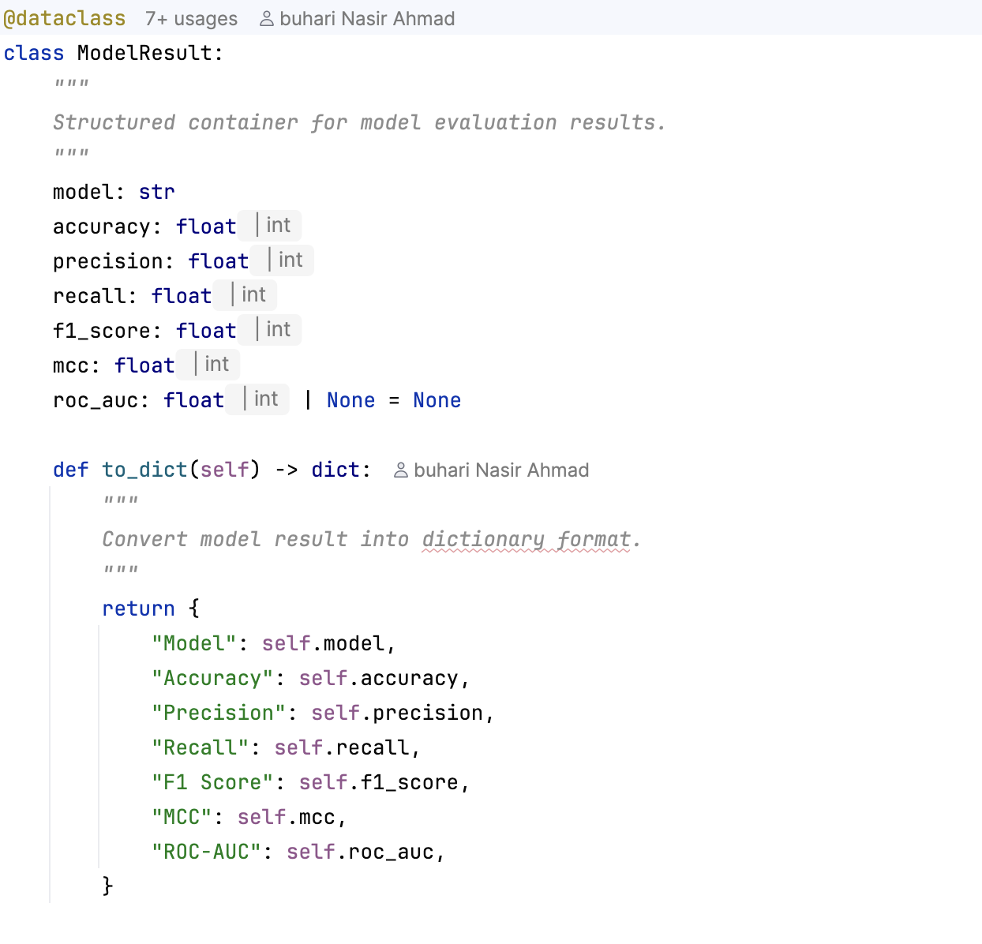
Applied Programming for Data Science
Python Programming Concepts Used
Dataclasses & OOP
Object-Oriented Programming
Structured data containers
Cleaner result management
Encapsulation of model metrics
11
Notes:
Object-oriented programming concepts were applied through the use of dataclasses.
A dataclass called ModelResult was created to store evaluation metrics for each model.
Instead of storing results in multiple variables or dictionaries, all metrics are grouped into a single object. This improves organization and makes the code easier to maintain.
Dataclasses were particularly useful because they automatically generate constructors and reduce boilerplate code while still supporting object-oriented design principles.

Slide 12
Applied Programming for Data Science
Python Programming Concepts Used
Documentation & Docstrings
Self-documenting code
Easier maintenance
Improved readability
Supports reproducibility
12
Notes:
Documentation is essential for reproducibility and collaboration.
Every major function in the project contains descriptive docstrings explaining its purpose, inputs, outputs, and expected behavior.
Proper documentation allows another developer to understand the code without reading the entire implementation.
This is especially important in data science projects where workflows can become complex and difficult to follow.

Slide 13
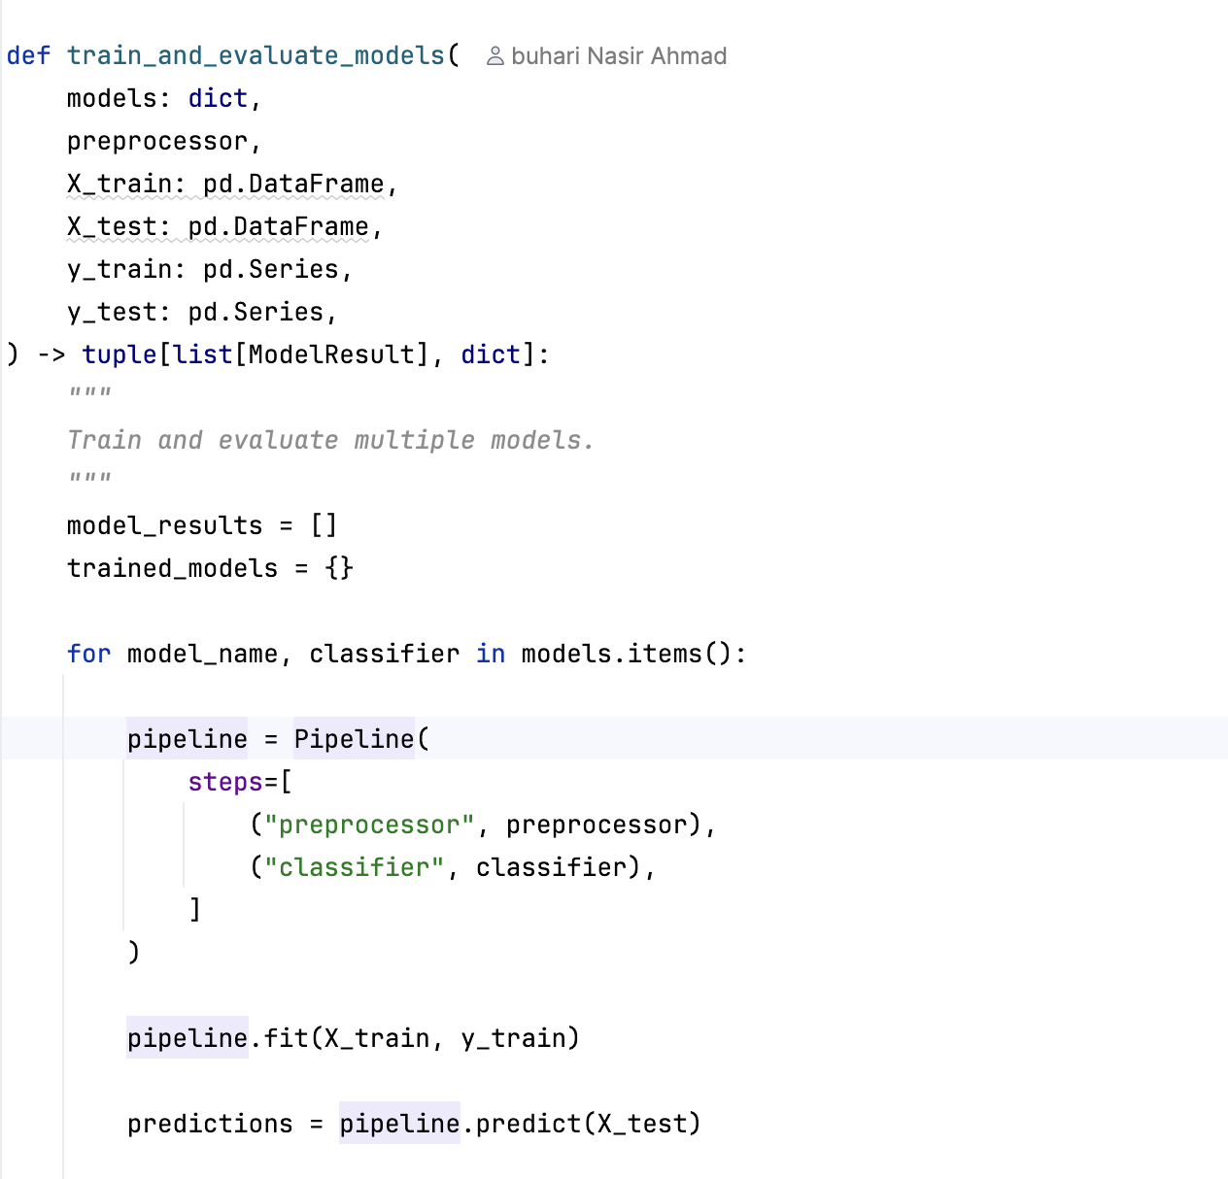
Applied Programming for Data Science
Python Programming Concepts Used
Machine Learning Pipelines
Scikit-learn Pipeline
Automated preprocessing
Prevents data leakage
Reusable workflow
13
Notes:
Machine learning pipelines were used to combine preprocessing and model training into a single reusable workflow.
The pipeline automatically applies preprocessing steps before training the classifier. This ensures consistency between training and testing data.
Pipelines also help prevent data leakage because preprocessing parameters are learned only from the training data and then applied to the test data.
This improves reproducibility and ensures that evaluation results are realistic.

Slide 14
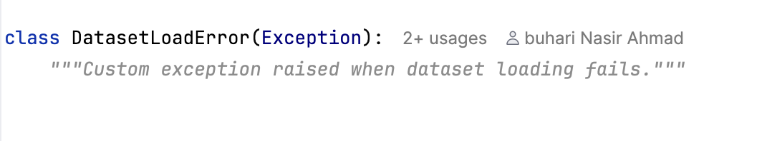
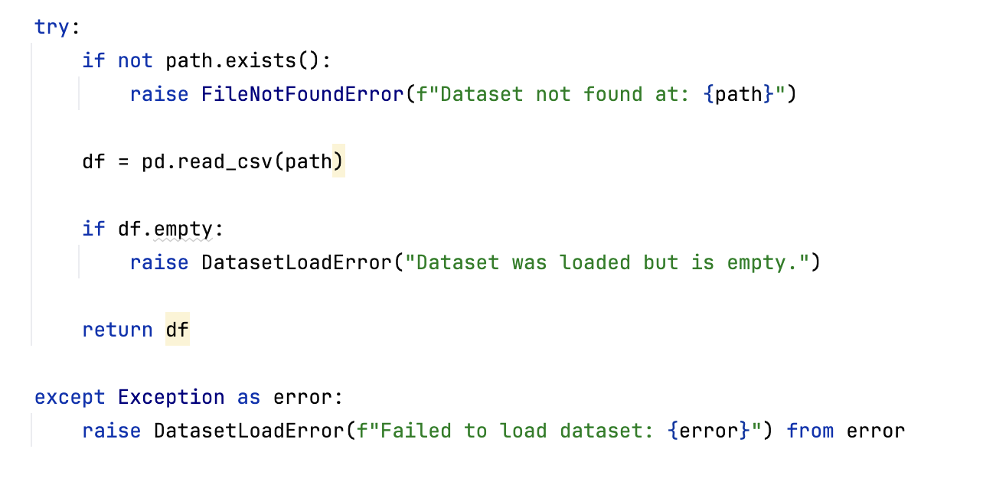
Applied Programming for Data Science
Python Programming Concepts Used
Exception Handling
Robust code
Error detection
Meaningful feedback
Improved reliability
14
Notes:
Robust software should handle unexpected situations gracefully.
Exception handling was implemented to detect problems such as missing datasets or invalid data.
Instead of allowing the application to fail silently, meaningful error messages are provided to help identify the cause of the problem.
This improves reliability and makes debugging much easier.

Slide 15
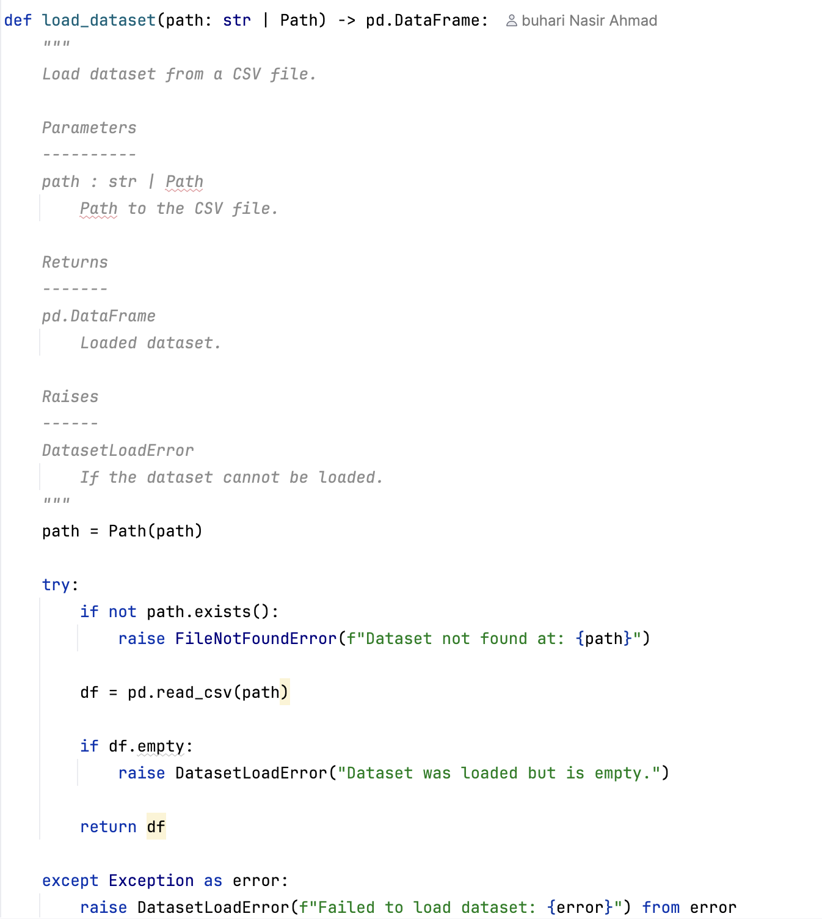
Income Classification Using Machine Learning
Python Programming Concepts Used
Data Loading & Validation
CSV dataset loading
Dataset validation
Error checking
Reproducible data ingestion
15
Notes:
Before any analysis can begin,
the dataset must be loaded and validated.
The loading function checks whether the file exists and verifies that the dataset is not empty before continuing.
This validation step ensures that the rest of the pipeline operates on valid input data and prevents errors later in the workflow.
It also contributes to reproducibility because the same loading procedure is applied every time the project is executed.

Slide 16
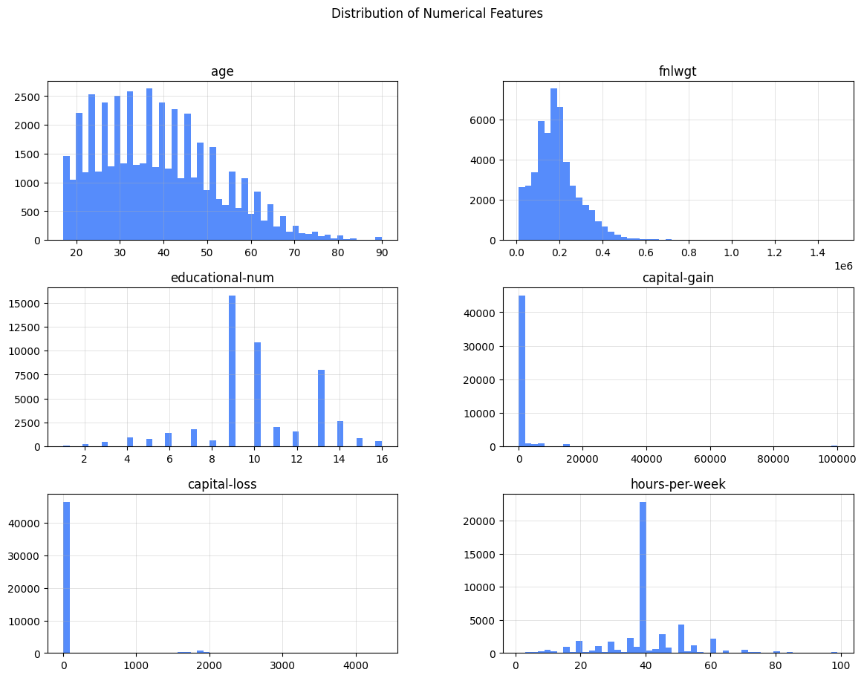
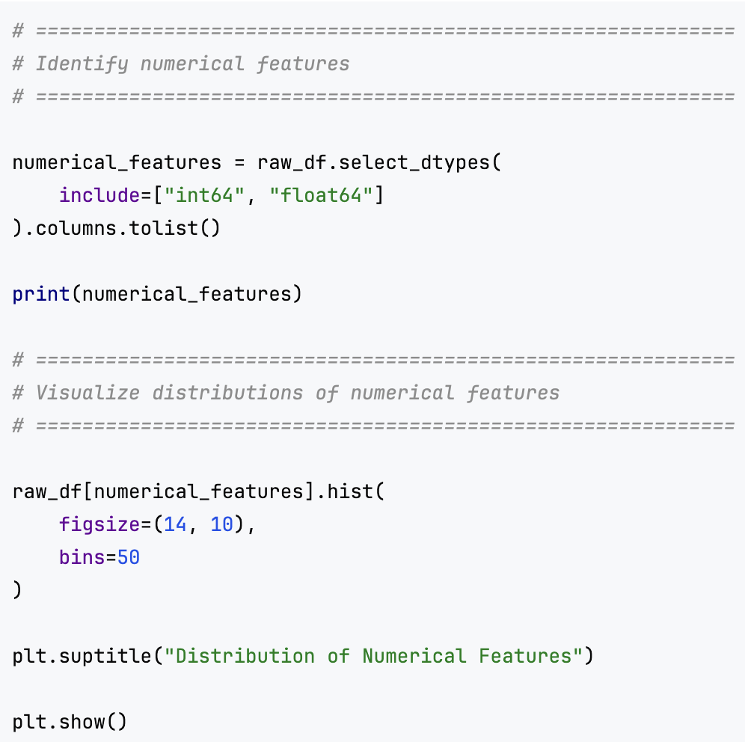
Income Classification Using Machine Learning
Exploratory Data Analysis
16
Notes:
Before preprocessing the dataset,
I performed exploratory data analysis to better understand the numerical variables.
I selected the numerical features and covert them to list and use Matplotlib to plot the historygrams which allow me to understand the data distribution and what to do in the next step of data preprocessing

Slide 17
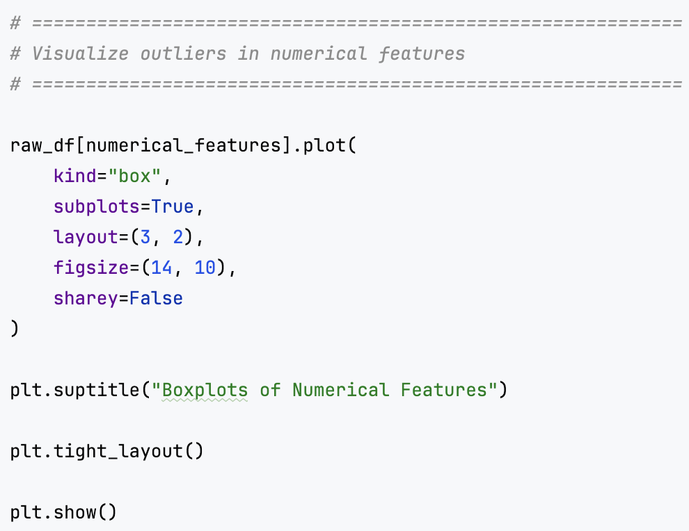
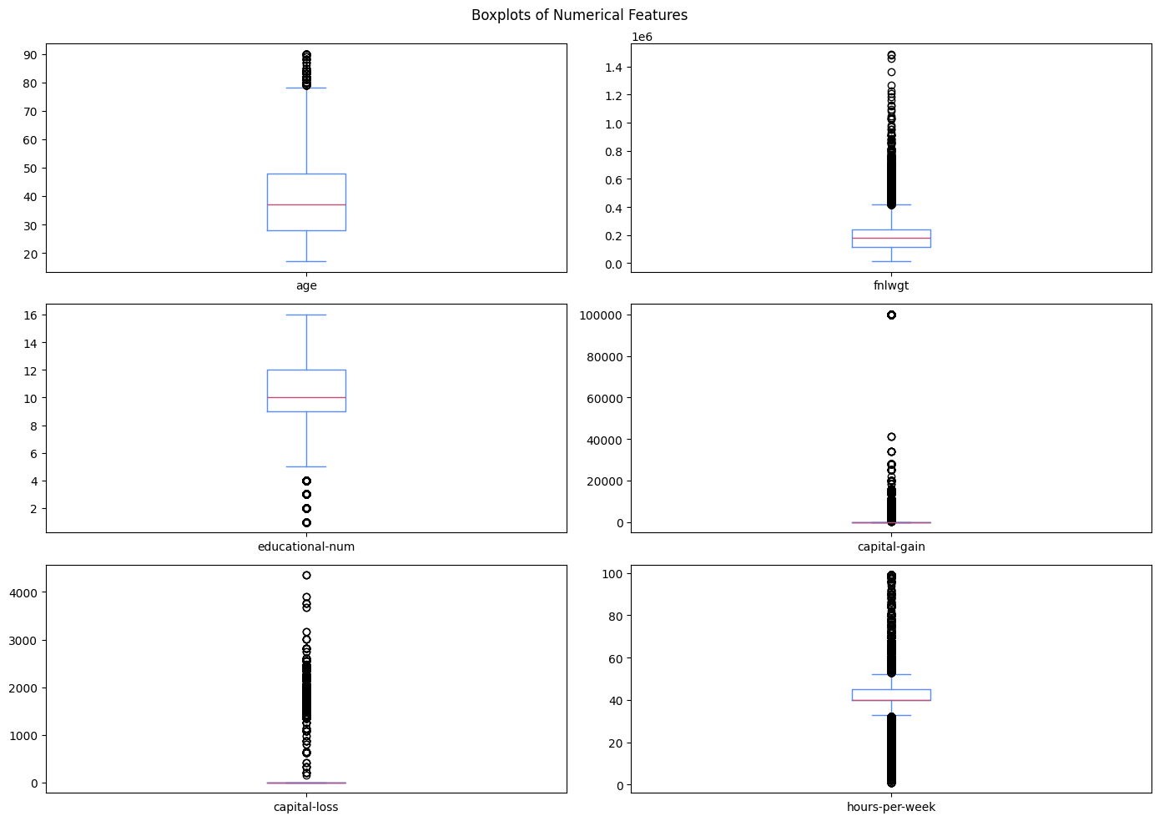
Income Classification Using Machine Learning
Exploratory Data Analysis
17
Notes:
Next, I analyzed potential outliers using boxplots.
Several numerical features contained extreme values, particularly capital gain and capital loss.
Rather than removing these observations, I investigated whether they represented legitimate values. Since they correspond to actual financial information, they were retained.
However, their strong skewness motivated the use of log transformations later in the preprocessing stage.
This demonstrates how exploratory analysis directly informed subsequent feature engineering decisions.

Slide 18
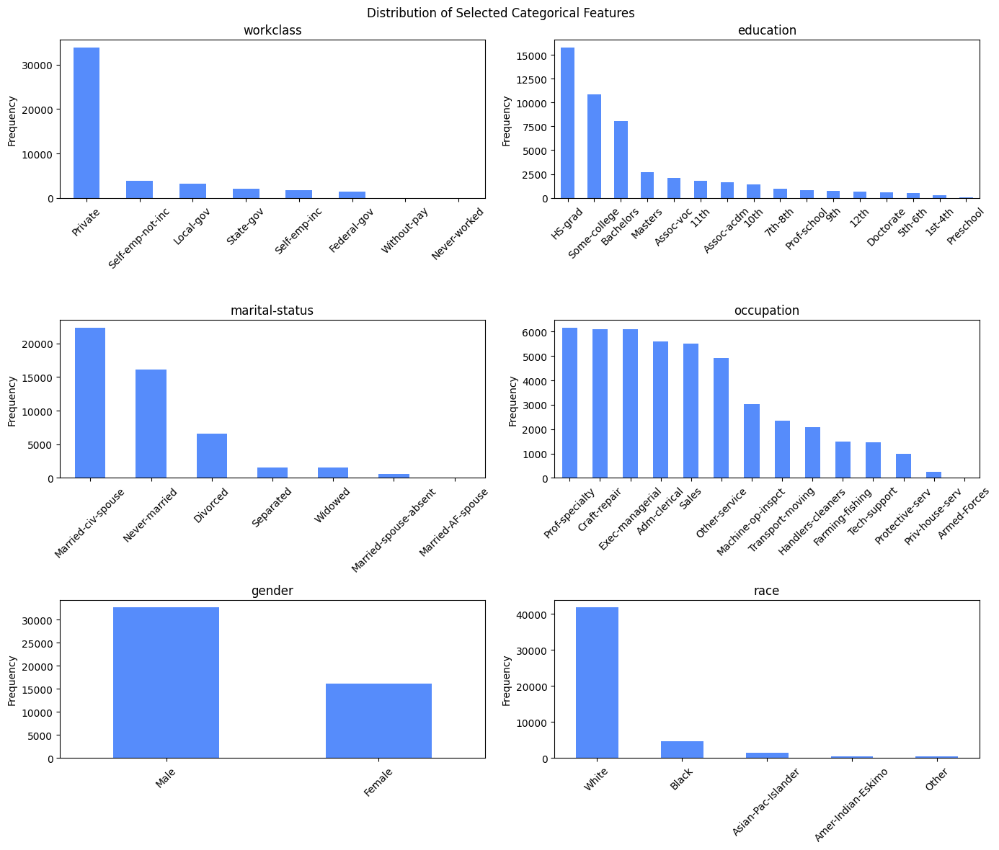
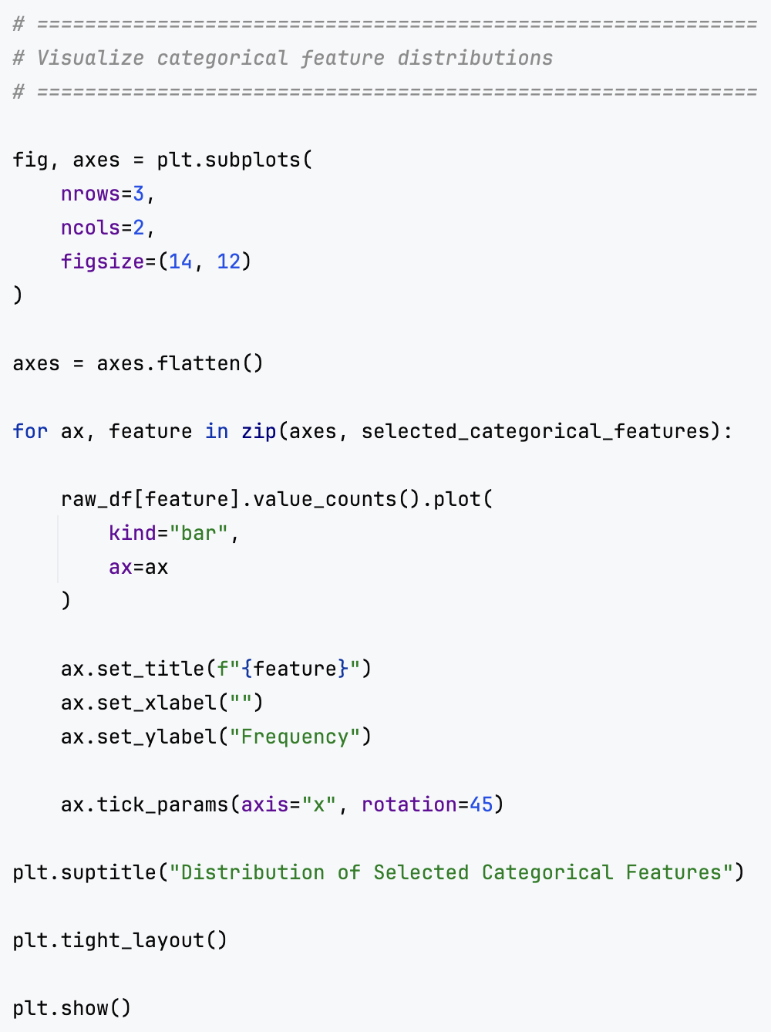
Income Classification Using Machine Learning
Exploratory Data Analysis
18
Notes:
I also examined the distribution of categorical variables such as occupation, education, marital status, gender, and race.
The analysis showed that some categories contained many observations while others had relatively few.
This imbalance suggested that certain categorical variables could benefit from grouping similar categories together.
Understanding category distributions is important because high-cardinality categorical features can increase model complexity and lead to sparse feature representations after encoding.

Slide 19
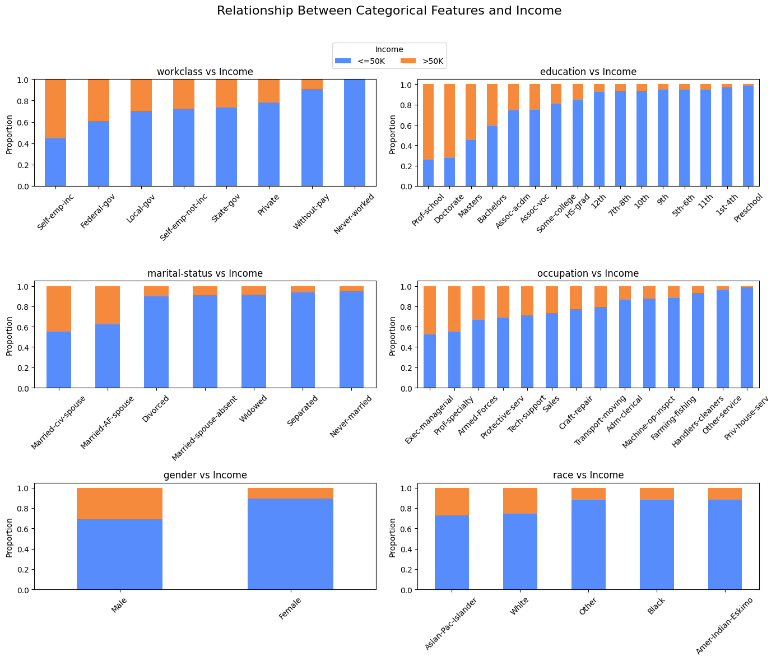
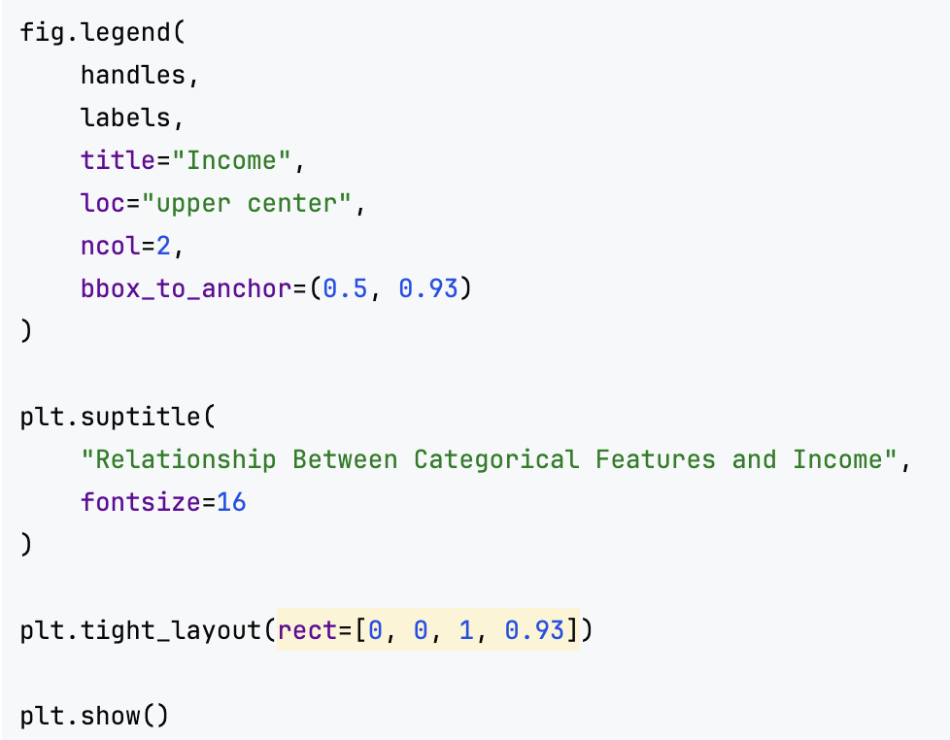
Income Classification Using Machine Learning
Exploratory Data Analysis
19
Notes:
To understand the relationship between categorical features and income, I created normalized stacked bar charts.
These visualizations showed how income levels varied across education groups, occupations, marital status categories, and demographic groups.
Several strong patterns emerged. For example, higher education levels generally showed a larger proportion of individuals earning above fifty thousand dollars.
These relationships indicated that categorical features would likely provide important predictive information for the classification models.

Slide 20
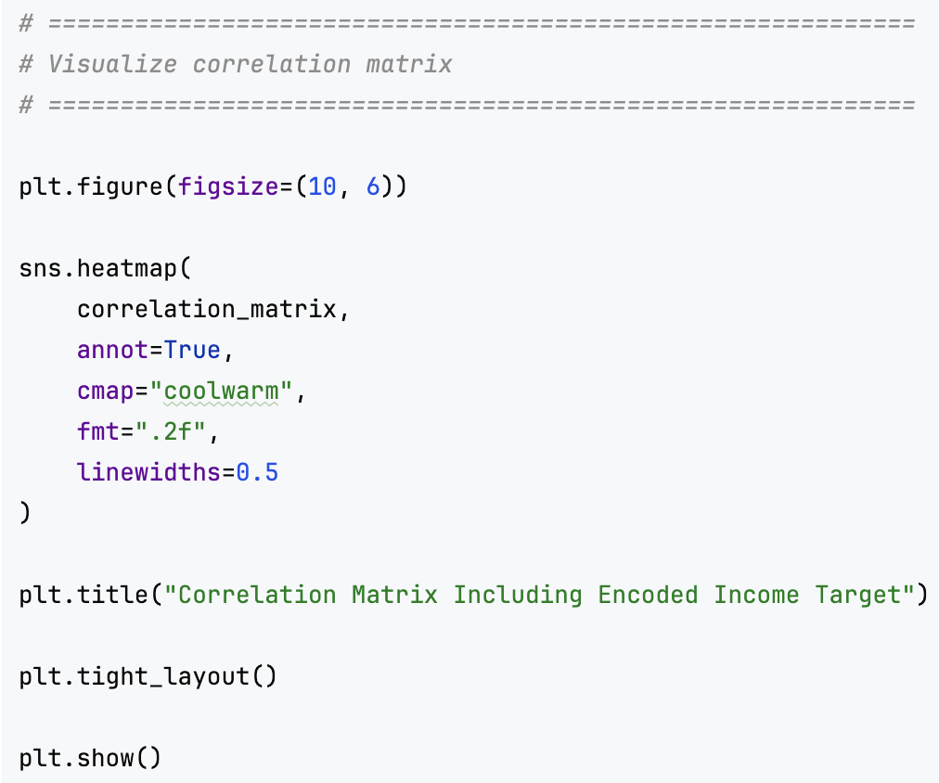
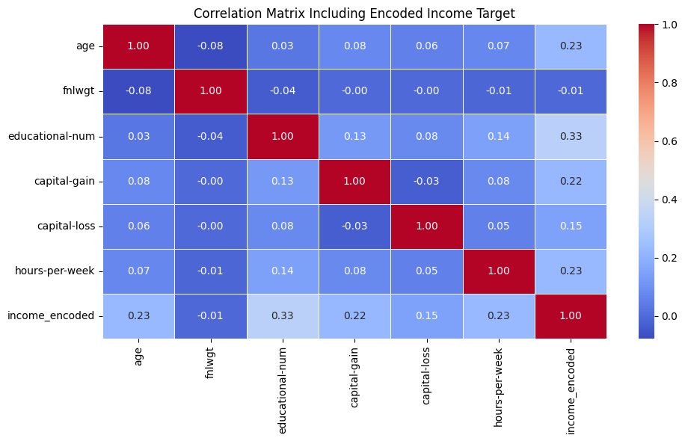
Income Classification Using Machine Learning
Exploratory Data Analysis
20
Notes:
Finally, I analyzed correlations among numerical variables using a correlation heatmap.
The objective was to identify relationships between features and the target variable as well as detect potential redundancy between predictors.
Although no extremely strong correlations were observed among most variables, features such as education level, capital gain, and hours worked per week showed meaningful associations with income.
This analysis helped confirm that the selected features contained useful predictive information for the modelling stage.

Slide 21
3. Data Preprocessing & Feature Engineering
21
Notes:
After understanding the structure and characteristics of the dataset through exploratory analysis, the next step was preparing the data for machine learning.
This involved cleaning the dataset, handling missing values, engineering new features, reducing sparsity, and transforming skewed variables.
The goal was to create a higher-quality dataset that would improve model performance while maintaining interpretability.
In the next slides, I will explain the preprocessing and feature engineering techniques that were implemented.

Slide 22
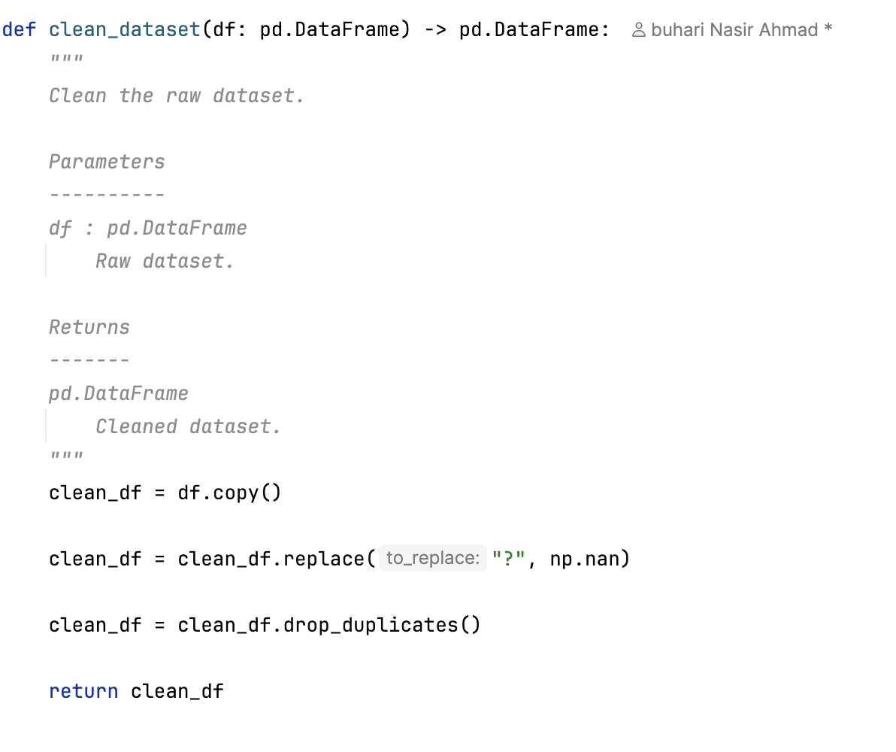
Income Classification Using Machine Learning
Data Preprocessing & Feature Engineering
Data Cleaning Pipeline
Missing value handling
Duplicate removal
Data consistency checks
Integrated preprocessing workflow
22
Notes:
After loading the dataset, the next stage was data cleaning. The dataset contained missing values represented by question marks and also contained duplicate records.
These issues were addressed through a dedicated cleaning function. Missing values were converted into proper null values and duplicates were removed.
By centralizing all cleaning logic in one place, the preprocessing workflow becomes easier to understand and maintain.

Slide 23
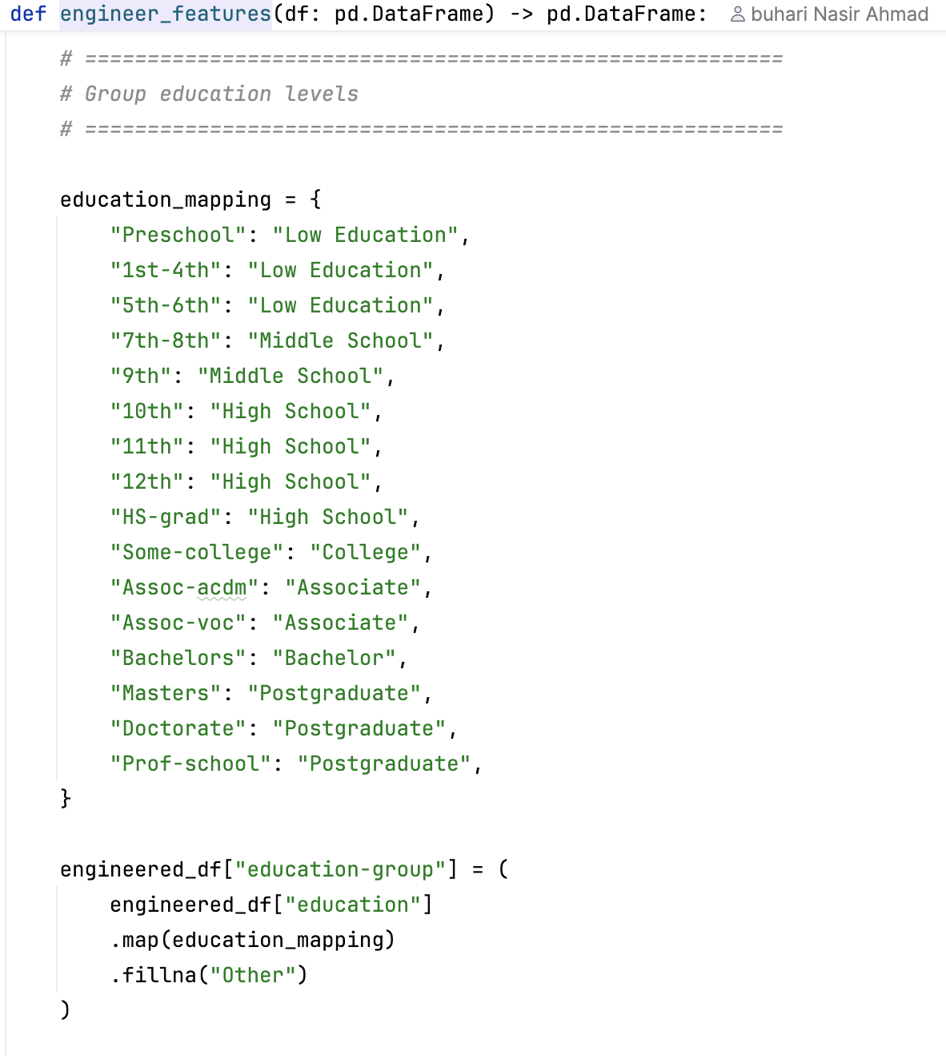
Income Classification Using Machine Learning
Data Preprocessing & Feature Engineering
Education Feature Engineering
Reduced high-cardinality categories
Grouped similar education levels
Improved model generalization
Reduced feature sparsity
Example Groups
School Education
High School
Associate Degree
Bachelor Degree
Postgraduate Degree
23
Notes:
Education originally contained many detailed categories with relatively small numbers of observations. Examples included different school levels, associate degrees, bachelor's degrees, and postgraduate qualifications.
To reduce sparsity, similar education categories were grouped into broader categories such as High School, Bachelor, and Postgraduate.
This transformation reduced dimensionality while preserving the semantic meaning of the feature, helping models generalize more effectively.

Slide 24
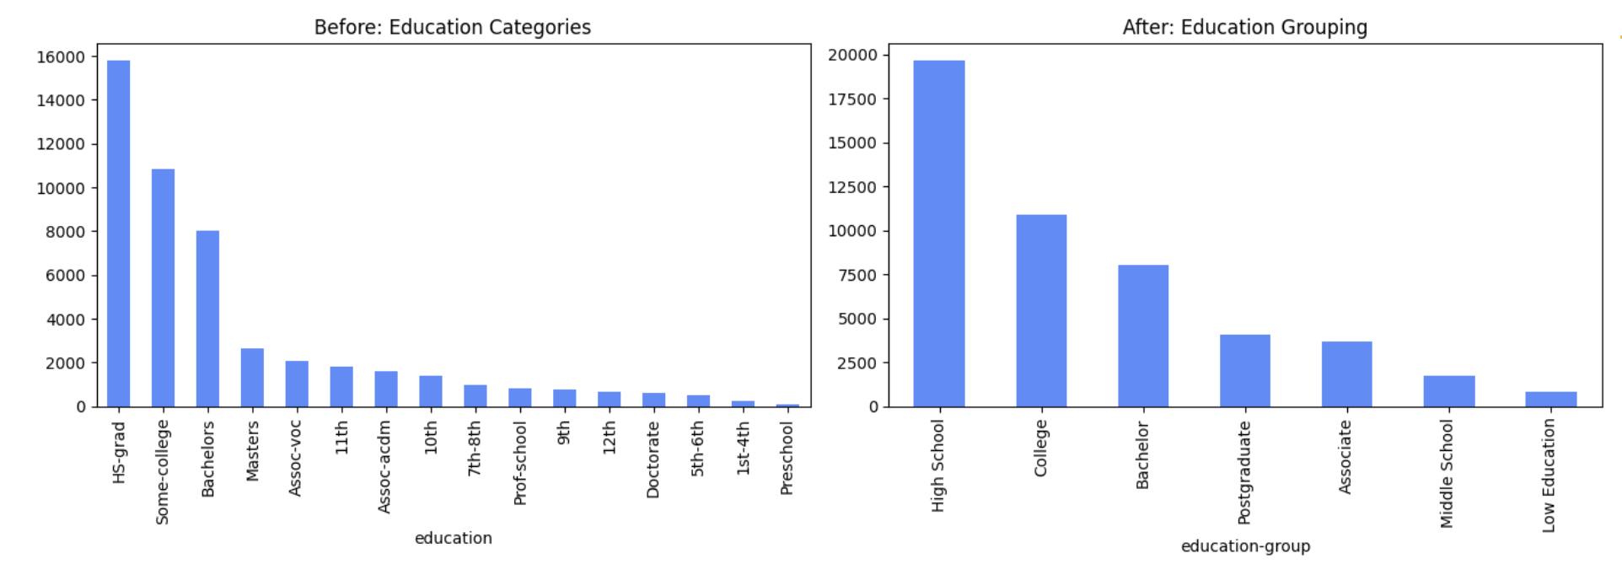
Income Classification Using Machine Learning
Data Preprocessing & Feature Engineering
Education Grouping
Original education had many detailed categories
Grouped into broader education levels
Examples: High School, Bachelor, Postgraduate
Reduced sparsity while preserving meaning
24
Notes:
Before and after

Slide 25
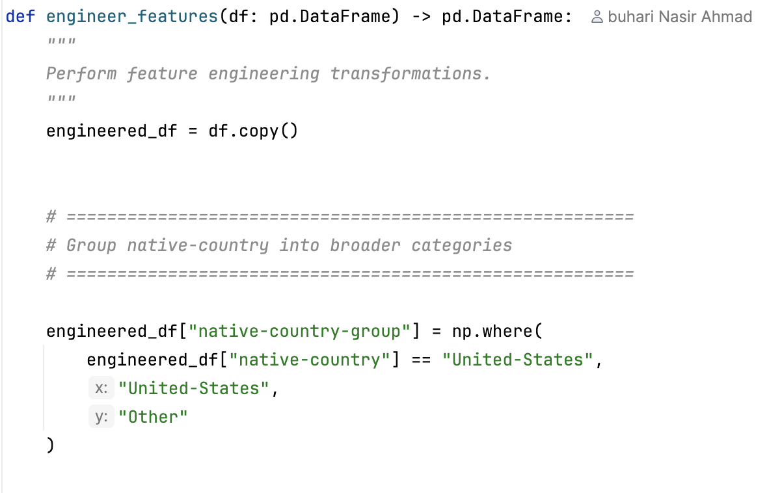
Income Classification Using Machine Learning
Data Preprocessing & Feature Engineering
Country Feature Engineering
Reduced country categories
Grouped countries into two
Reduced dimensionality
Improved robustness
Example Regions
USA
Other
25
Notes:
The native-country feature contained many country categories, but most observations belonged to the United States.
To reduce complexity, countries were grouped into two categories: United States and Other.
This simplified the feature while retaining useful information and reducing the number of sparse categories that the model needed to handle.

Slide 26
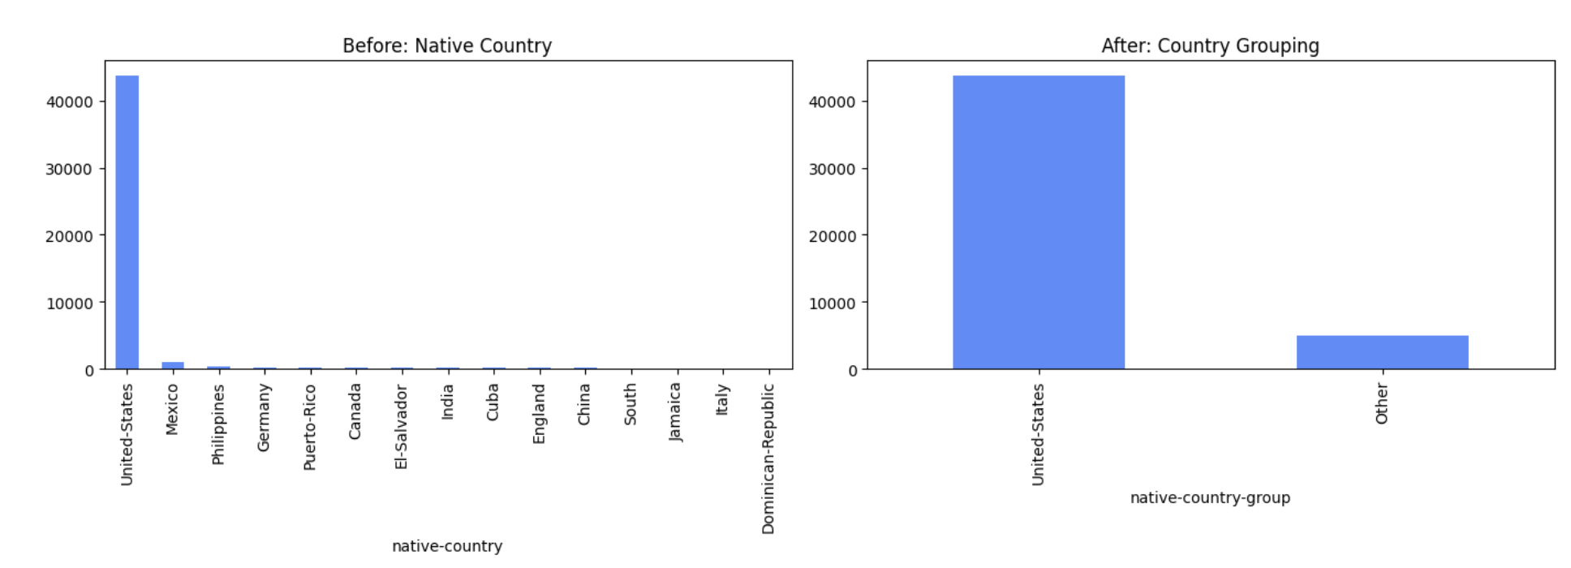
Income Classification Using Machine Learning
Data Preprocessing & Feature Engineering
Native Country Grouping
Original native-country had many country categories
Most observations were from the United States
Created native-country-group
Categories: United States / Other
26
Notes:
Before and after

Slide 27
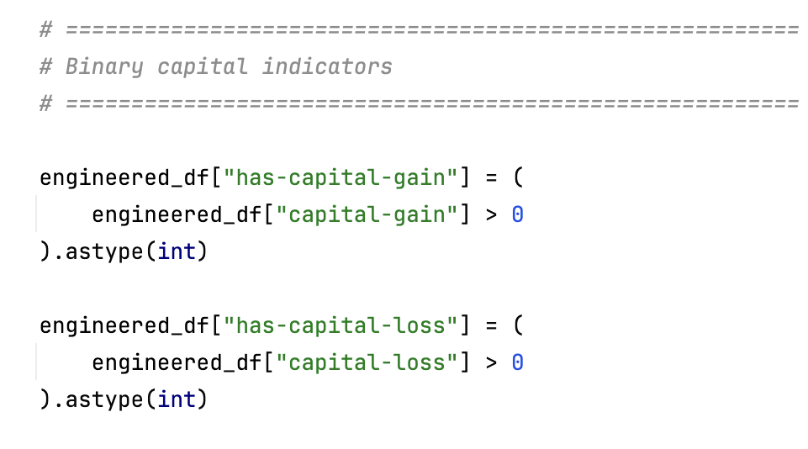
Income Classification Using Machine Learning
Data Preprocessing & Feature Engineering
Capital Gain & Capital Loss Features
Highly skewed variables
Many zero values
Created indicator variables
Improved interpretability
27
Notes:
Capital gain and capital loss were highly skewed variables. Most individuals had zero values, while a small number of observations contained very large values.
To improve interpretability, binary indicator features were created to capture whether an individual had any capital gain or loss.
These features separate the existence of investment-related income from its actual amount, providing additional information to the models.

Slide 28
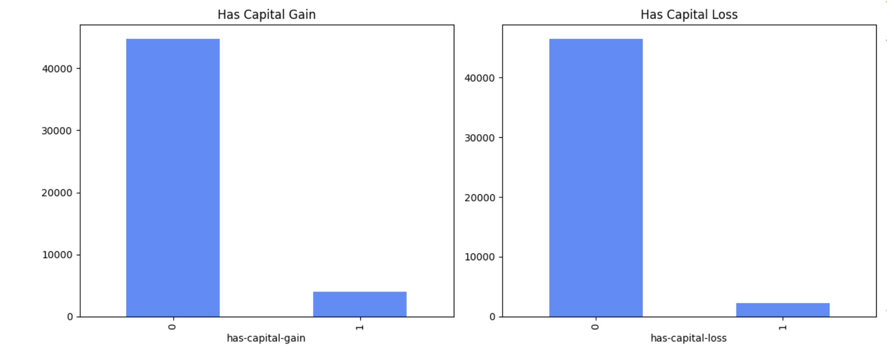
Income Classification Using Machine Learning
Data Preprocessing & Feature Engineering
Capital Gain and Capital Loss Indicators
Created binary indicators:
has-capital-gain
has-capital-loss
Captures whether investment-related income/loss exists
Separates “presence” from “amount”
28
Notes:
The new features variable

Slide 29
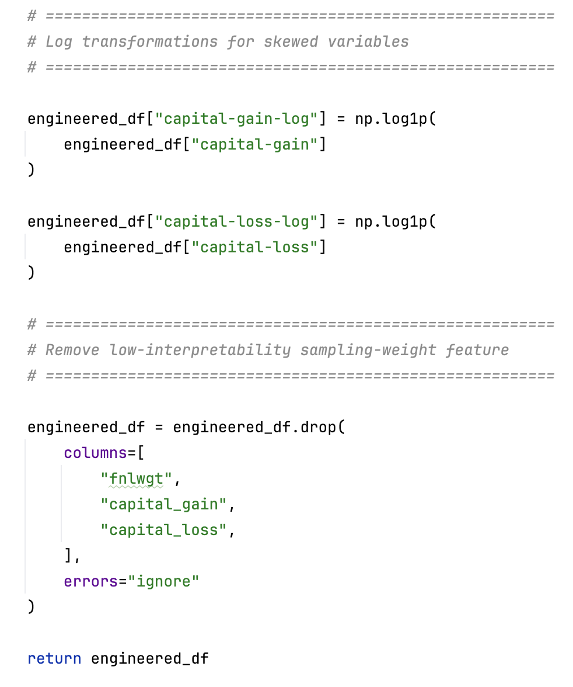
Income Classification Using Machine Learning
Data Preprocessing & Feature Engineering
Log Transformations
Reduced skewness
Stabilized variance
Improved model learning
Feature Selection
Removed irrelevant features
Reduced noise
Improved efficiency
29
Notes:
Because capital gain and capital loss contained extreme outliers, log transformations were applied.
The log transformation compresses large values and reduces skewness, producing a more balanced distribution.
This often improves model learning because algorithms can focus on meaningful patterns instead of being dominated by a few extreme observations.

Slide 30
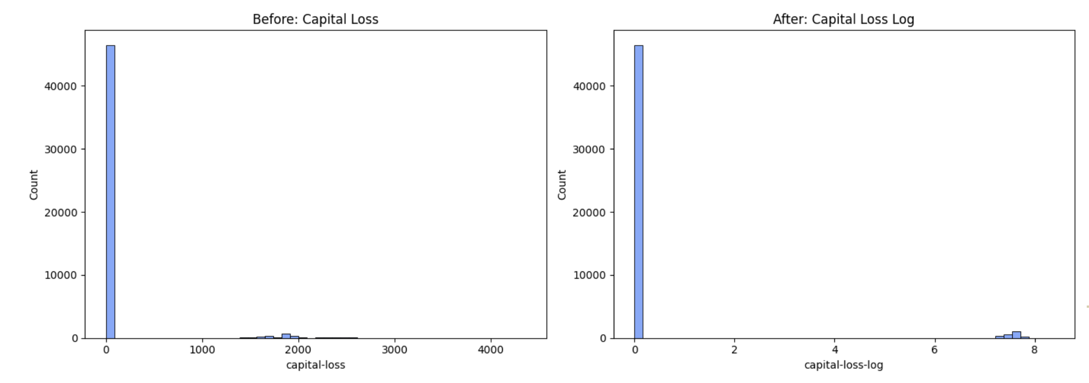
Income Classification Using Machine Learning
Data Preprocessing & Feature Engineering
Log Transformation of Skewed Variables
capital-gain and capital-loss were highly right-skewed
Most values were zero
Few observations had very large values
Applied log1p transformation Created:
capital-gain-log
capital-loss-log
30
Notes:
To compare different machine learning approaches, I implemented a reusable model registry function that returns all candidate classifiers.
Four models were selected: Logistic Regression, Decision Tree, Random Forest, and Gradient Boosting.
These algorithms represent different levels of complexity and interpretability, allowing a fair comparison of modelling approaches.

Slide 31
Machine Learning Pipeline & Hyperparameter Tuning
31

Slide 32
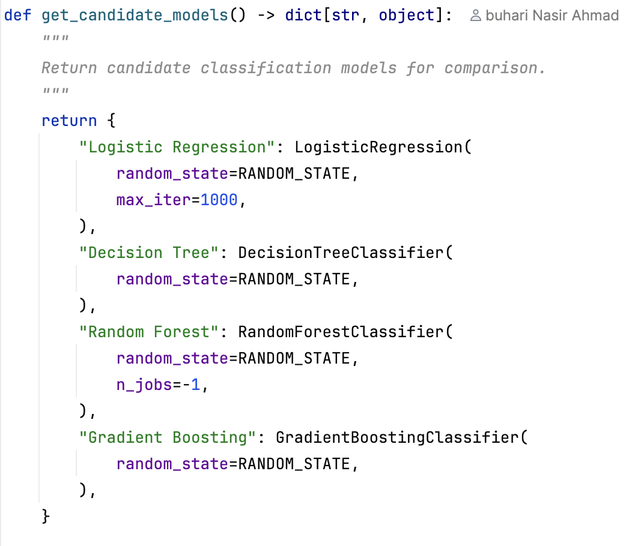
Income Classification Using Machine Learning
Model Training & Hyperparameter Tuning
Compared multiple classification algorithms
Created a reusable model registry
Consistent configuration across experiments
Enabled fair model comparison
Models Evaluated
Logistic Regression
Decision Tree
Random Forest
Gradient Boosting
32
Notes:
Instead of manually creating and training each model throughout the notebook, I implemented a reusable function called get_candidate_models(). This function acts as a model registry and returns all candidate classifiers in a single dictionary.
This approach improves maintainability because new models can be added in one location without modifying the training pipeline. It also ensures that all models are evaluated using the same preprocessing steps, train-test split, and evaluation metrics, making comparisons fair and reproducible.
The selected models represent different machine learning approaches. Logistic Regression serves as a simple linear baseline, Decision Tree provides interpretable rule-based predictions, Random Forest introduces ensemble learning, and Gradient Boosting offers a more advanced boosting-based approach. The objective was to compare models with different levels of complexity and interpretability before selecting the best-performing solution.

Slide 33
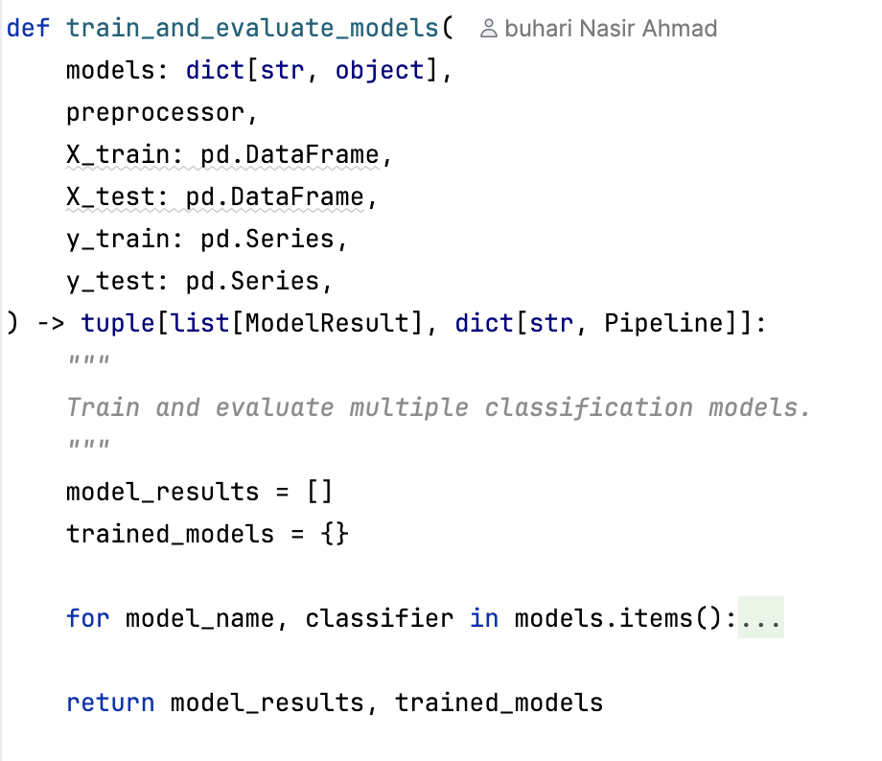
Income Classification Using Machine Learning
Model Training & Hyperparameter Tuning
Model Training & Evaluation
Train multiple models automatically
Reusable training workflow
Pipeline-based preprocessing
Consistent model evaluation
Store trained models for later analysis
Key Steps
Create Pipeline
Train Model (fit)
Generate Predictions
Calculate Probabilities
Evaluate Performance
Store Results
33
Notes:
This function is the core of the training framework. Instead of writing separate code for every model, a loop automatically trains and evaluates each classifier.
For every model, a pipeline is created, trained on the training data, and used to generate predictions on the test data.
Evaluation metrics are calculated through a reusable evaluation function and stored in ModelResult objects.
This design reduces code duplication and makes it easy to add new models in the future.

Slide 34
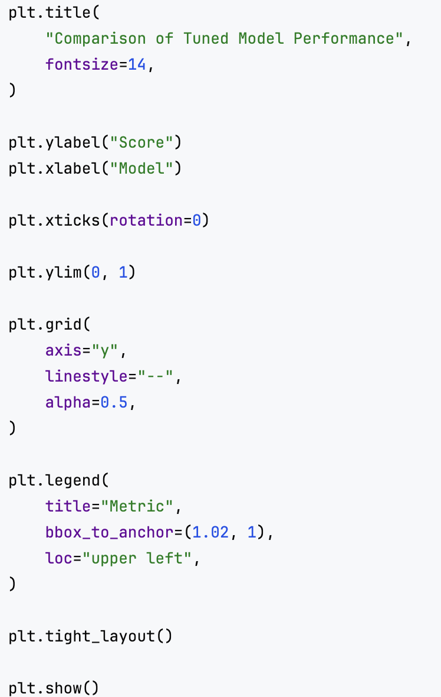
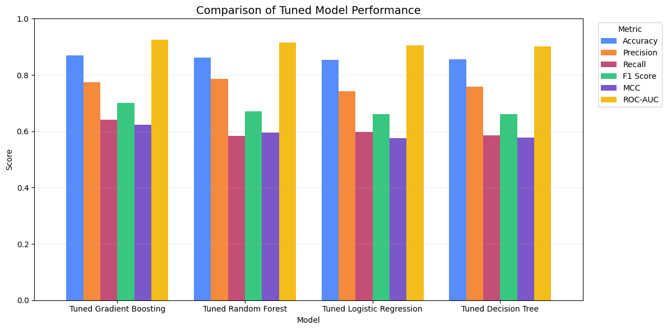
Income Classification Using Machine Learning
Tuned Model Performance Comparison
34
Notes:
After training the models, hyperparameter tuning was performed to improve performance. The tuned models were then compared using multiple evaluation metrics including Accuracy, Precision, Recall, F1 Score, MCC, and ROC-AUC.
Comparing multiple metrics is important because no single metric provides a complete picture of model performance.

Slide 35
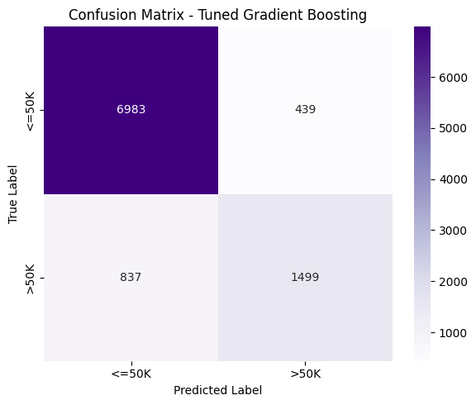
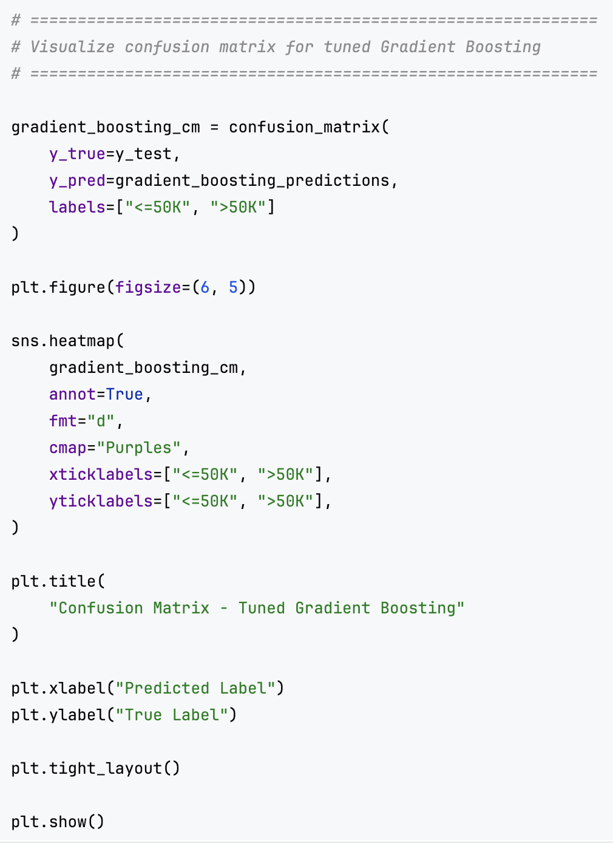
Income Classification Using Machine Learning
Confusion Matrix (Best Model)
35
Notes:
The confusion matrix provides a detailed breakdown of model predictions. It shows how many observations were correctly classified and where errors occurred.
This allows us to understand whether the model is making more false positives or false negatives, which is often more informative than accuracy alone.

Slide 36
Model Interpretability & Responsible AI Evaluation
36

Slide 37
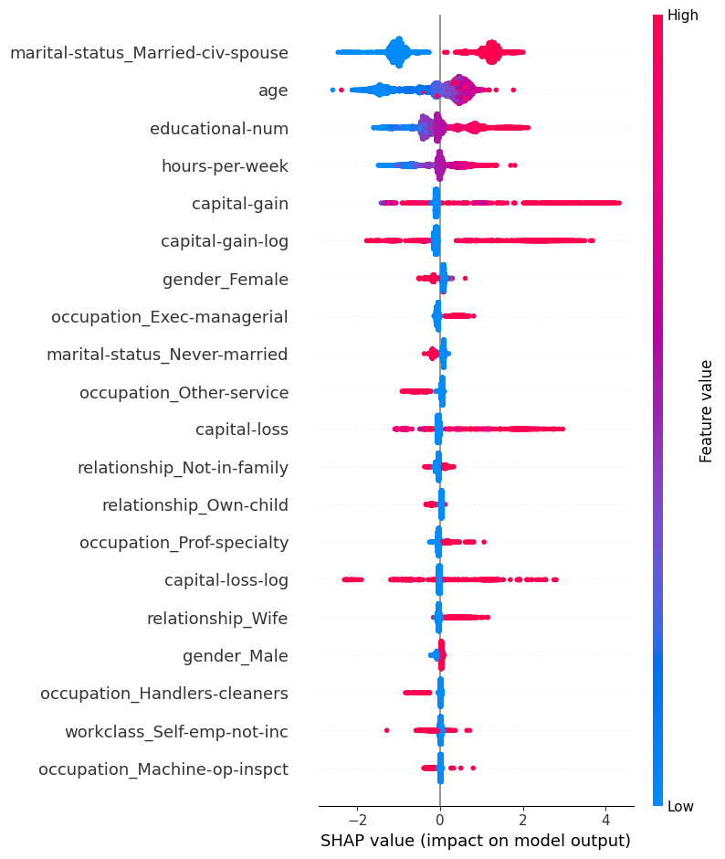
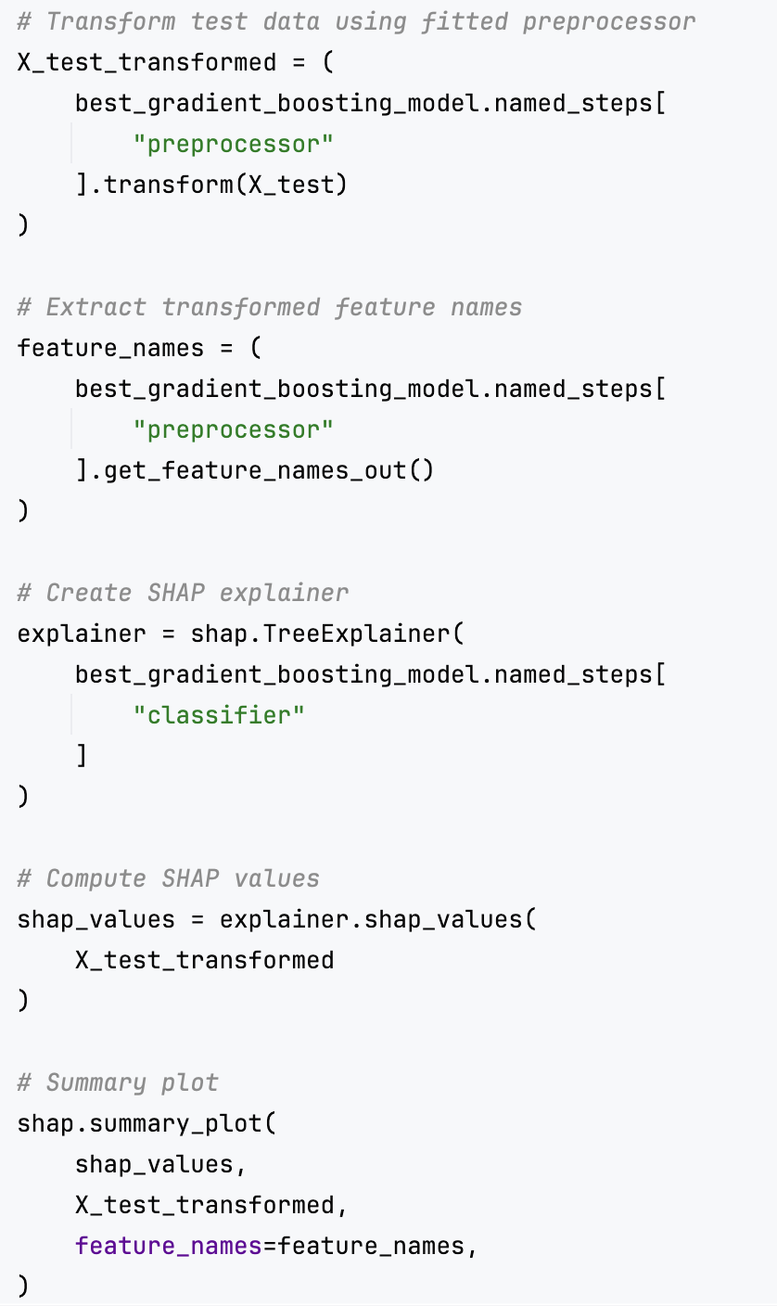
Income Classification Using Machine Learning
Model Interpretability (SHAP Analysis)
37
Notes:
To better understand the behavior of the final Gradient Boosting model, I used SHAP, which stands for SHapley Additive exPlanations.
SHAP is a model-agnostic interpretability technique that explains how each feature contributes to predictions. Unlike traditional feature importance methods, SHAP not only shows which features are important but also whether they increase or decrease the likelihood of predicting the high-income class.
The results show that marital status, age, education level, capital gain, and hours worked per week were among the most influential factors affecting income predictions.
For example, being married, having higher educational attainment, higher capital gains, and working more hours generally increased the probability of belonging to the high-income class.
The SHAP analysis provides transparency into the model's decision-making process and confirms that the model learned meaningful socioeconomic patterns rather than relying on arbitrary relationships.

Slide 38
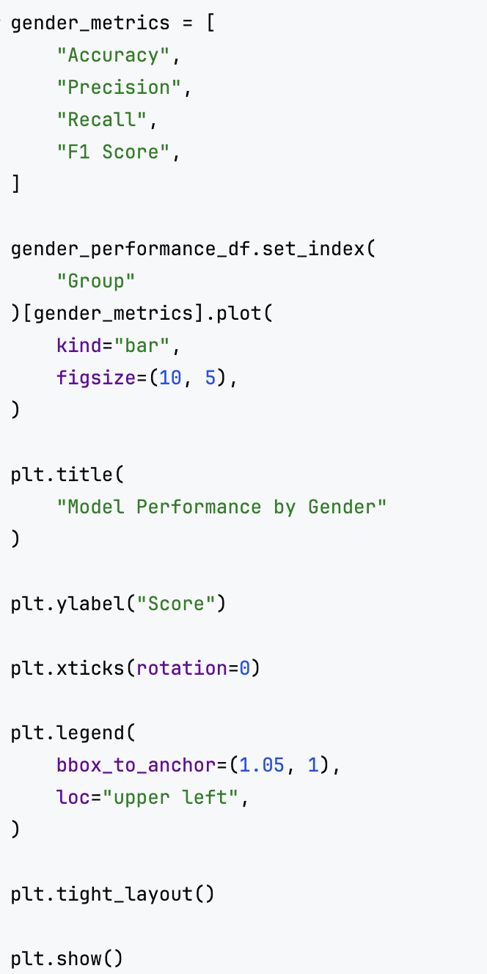
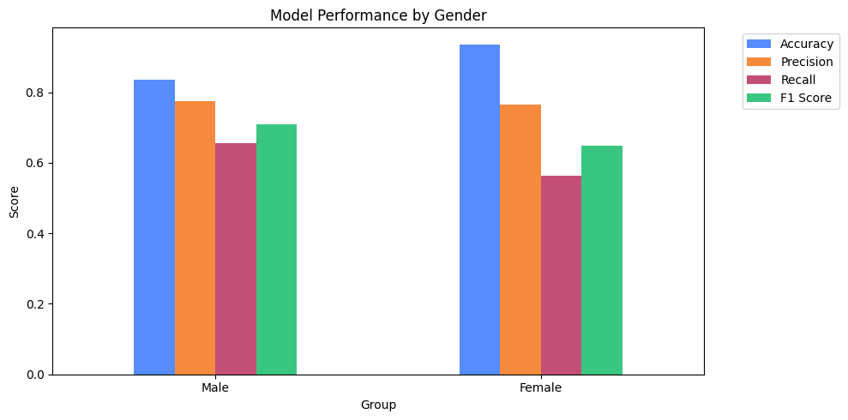
Income Classification Using Machine Learning
Responsible AI Evaluation: Gender Fairness
38
Notes:
Beyond predictive performance, I also evaluated fairness across demographic groups.
The objective was to determine whether the model performs differently for different genders and racial groups.
While the model achieved strong overall performance, the analysis revealed some disparities between groups, highlighting the importance of evaluating machine learning systems beyond traditional accuracy metrics.

Slide 39
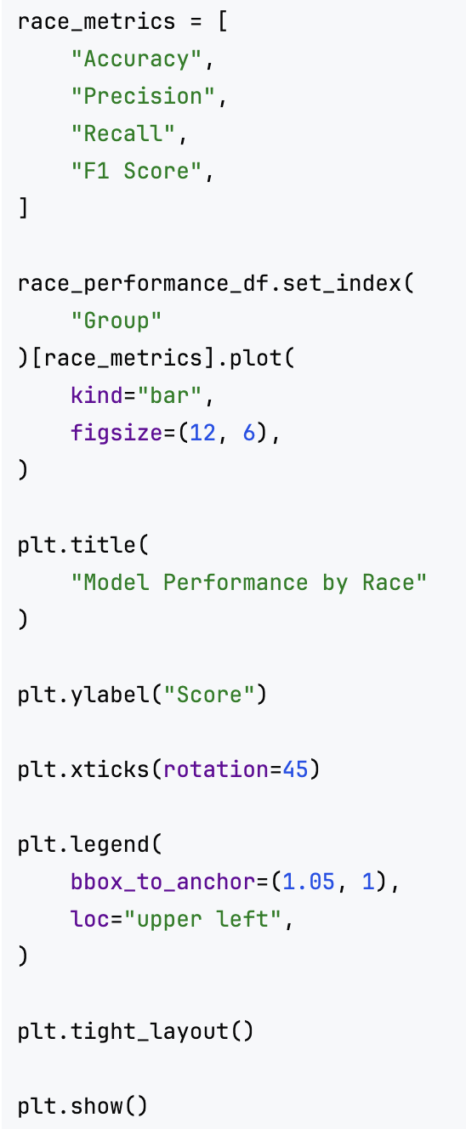
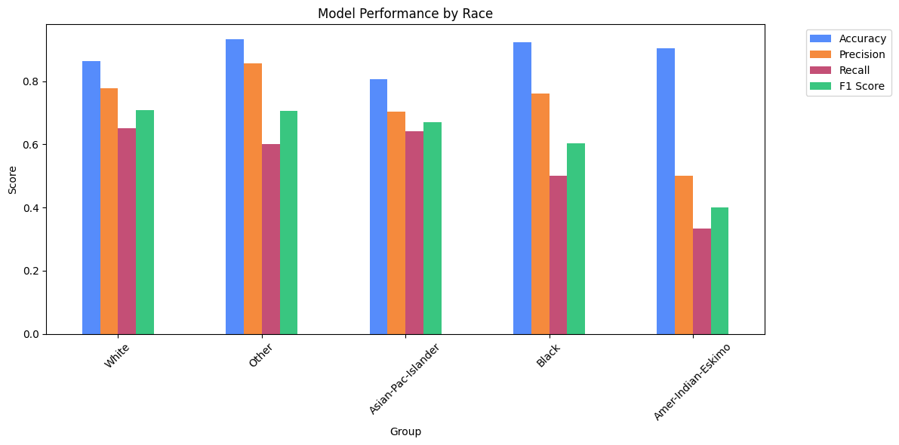
Income Classification Using Machine Learning
Responsible AI Evaluation: Race Fairness
39

Slide 40
Limitations and Future Improvements
40

Slide 41
Income Classification Using Machine Learning
Limitations and Future Improvements
Key Limitations
Dataset age: The Adult Income dataset is based on the 1994 U.S. Census and may not fully reflect current socioeconomic conditions.
Correlation ≠ Causation: The models identify predictive relationships but cannot determine causal factors influencing income.
Small demographic subgroups: Some racial groups contain relatively few observations, leading to less reliable fairness estimates.
Limited hyperparameter search space: More extensive optimization techniques could potentially improve model performance further.
Fairness evaluation scope: The analysis focused on demographic group performance and did not include advanced fairness metrics such as demographic parity or equal opportunity.
41
Notes:
Like any project, this work has several limitations. The dataset is based on the 1994 U.S. Census and may not fully reflect modern socioeconomic conditions. Some demographic groups also contain relatively few observations, making fairness estimates less reliable.
Future work could include evaluating more recent datasets, exploring additional feature engineering techniques, testing more advanced algorithms such as XGBoost, and incorporating fairness-aware learning methods.

Slide 42
Income Classification Using Machine Learning
Limitations and Future Improvements
Potential Future Improvements
Evaluate on more recent socioeconomic datasets.
Explore additional feature engineering techniques.
Apply advanced hyperparameter optimization methods.
Investigate fairness-aware machine learning approaches.
Compare with additional algorithms such as XGBoost or LightGBM.
Expand interpretability analysis using local SHAP explanations.
42

Slide 43
Income Classification Using Machine Learning
Conclusion
Main Findings
Developed a complete end-to-end machine learning pipeline for income classification
Performed comprehensive data cleaning, preprocessing, and feature engineering
Evaluated and compared four machine learning algorithms
Hyperparameter tuning improved model performance across all models
Gradient Boosting achieved the strongest overall predictive performance
SHAP analysis improved model interpretability and transparency
Fairness evaluation revealed performance disparities across demographic groups
Feature engineering contributed significantly to model effectiveness
43
Notes:
In conclusion, this project successfully implemented a complete end-to-end machine learning application in Python. The work covered data loading, cleaning, feature engineering, model training, evaluation, interpretability analysis, and fairness assessment.
From an Applied Programming perspective, the project demonstrates modular design, reusable components, object-oriented programming, documentation, exception handling, and reproducible workflows.
The final results showed that Gradient Boosting achieved the strongest overall predictive performance, while SHAP and fairness analysis provided additional insights into how the model behaves and how its predictions affect different demographic groups.
Overall, the project demonstrates how software engineering and machine learning can be combined to create robust, maintainable, and interpretable data science applications.

Slide 44
Thank You
Income Classification Using Machine Learning
Adult Census Dataset
Buhari Nasir Ahmad · Applied Programming for Data Science Project
Questions & Discussion

